Slide 1
Establishment of the Regional Database
for the Mediterranean and Black Seas
(RDBFIS-III)
Under framework contract – EASME/EMFF/2020/OP/0021
Specific Contract CINEA/EMFAF/2024/3.1/01/SC08
MEDITS COORDINATION GROUP
Málaga (Spain), 5th-7th May 2026
Málaga Oceanographic Centre (COMA)
RDBFIS OVERVIEW
Stefanos Kavadas

Slide 2
RDBFIS Phases (I, II, III)
MARE/2020/08 - SI2.839444
Development of the Regional Database for the
Mediterranean & Black Seas (Med&BS RDBFIS)
This project has financed under the European Maritime and Fisheries Fund (EMFF)
Phase I
Start: 01/01/2021
End: 28/02/2023
Coordinator: S. Kavadas
Phase II
Start: 01/04/2023
End: 31/03/2025
Coordinator: S. Kavadas
CINEA/EMFAF/2021/3.1.2/03/SC04/SI2.881222
Hosting, maintenance and further development of the Regional Database for the Mediterranean and Black Seas
Phase III
Start: 01/04/2025
End: 21/05/2026
Coordinators: I. Maina & S. Kavadas
CINEA/EMFAF/2024/3.1/01/SC08
Establishment of the Regional Database for the Mediterranean and Black Seas

Slide 3
RDBFIS III: Key activities
During the third phase of the RDBFIS implementation , in addition to supporting MS in data validation and uploading, as well as addressing specific requirements, the consortium focused on the following objectives:
system maintenance and fine-tuning
finalising the MEDIAS data base structure;
developing the MEDIAS R package (similar to RoME);
developing an R package for statistical analysis;
integration of SDTool package for sampling optimization;
substantially enhancing system performance, with a particular focus on the consistency check phase;
establishing collaboration with other consortia, with the aim of expanding the system through the integration of new components with the aim of enabling MS to use the platform to respond to multiple data requests (JRC, GFCM, ICES);
RDBFIS Transition to EU DIGIT – Collaboration with EU IT experts;
harmonizing RDBFIS with other platforms (JRC, GFCM);
participation in meetings (MED&BS RCG, Liaison, NC DCF meetings, LP RCG, ..)
workshops and internal meetings were organised to support system fine-tuning and development;
Notes:
Actions already performed
Participation in meetings:
MEDIAS SC
MEDITS SC
RCG ECON
RCG LP
SC RDB
MED&BS RCG
DCF Liaison Meeting
NC DCF meetings
A series of dedicated workshops and meetings focusing on fine-tuning and further development have been organised to facilitate the implementation of the project activities.

Slide 4

RDB and integrated components
Integrated Components
UI
Validation schemes (syntax checks)
RDBqc (consistency checks)
FDI spatial checks
RDBprocessing
RoME, RoMEBS
BioIndex
EU fleet analysis
MCDA for SSF
Mapping
Stomach content, Eggs&Larvae data entry forms
MEDIAS R package
stat4RDBFIS R package
SDTool package for sampling optimization
Med&BS RDB
Datacalls: Med&BS, FDI, DCRF, AER
Detailed biological data (CS)
Landings (CL)
Surveys: MEDITS, MEDIAS, Eggs&Larvae, LP
EU professional fleet
Stomach content
PETS
Alien species
Recreational
Coding
Environmental
Spatial data

Slide 5
populate the system with data
Aggregated data
Med&BS
FDI (Tables A, B, G, H, I, J)
AER
GFCM/DCRF
Detailed biological (CS) & landings (CL) data
Surveys data:
MEDITS (TA, TB, TC)
MEDIAS (acoustics, pelagic trawl, CTD)
A straight-forward process to upload data
Step 1. Syntax check (validation scheme)
csv
Step 2. Consistency check (quality control routines)
Step 3. Upload (update RDBFIS)
Notes:
A data call was drafted to the relevant Member States of the Med&BS region. The requested datasets covers the periods of the DCR & DCF programs
2002-2022 for Med&BS datacall,
2013-2022 for FDI datacall,
2017-2022 for GFCM/DCRF datacall,
Med&BS RCG data (DCR & DCF: fishing intensity, landings).
Detailed biological data
MEDITS data
AER data
The JRC and GFCM provided the requested datasets;
The Member States are invited to use the RDBFIS to execute syntax and data quality control procedures and store the clean data into the system (through a strict set of validation rules solid based on the datacall ANNEXES). A dedicated RDBFIS team support this process through bilateral contacts and working jointly with the Member States. The process is progressing satisfactorily, the RDBFIS core team supports all MSs’ requirements.

Slide 6
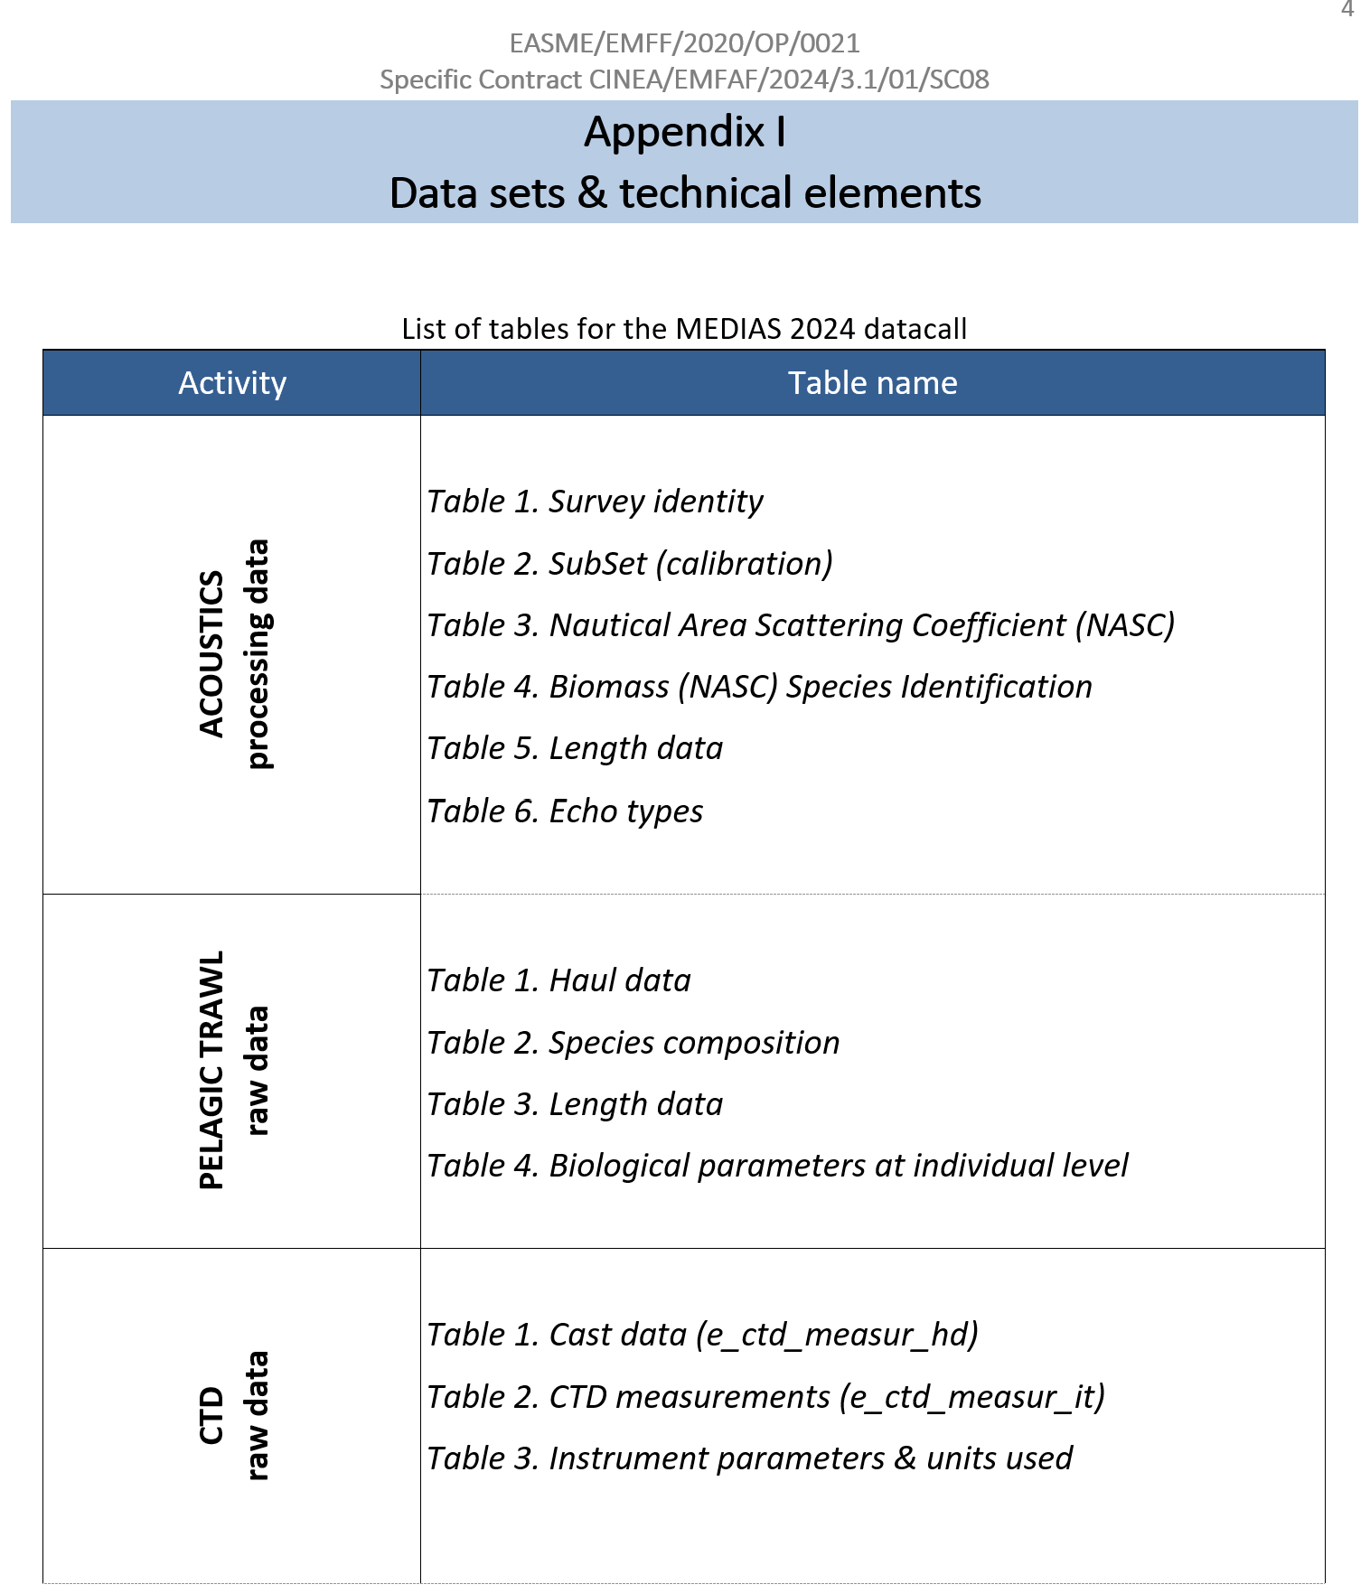
Data call for acoustics, pelagic trawl and CTD data
collected from MEDIAS survey in the Med&BS
Aim: to populate the system with relevant datasets collected during MEDIAS survey.
The RDBFIS consortium supports MS in the preparation of data call and data submission through bilateral meetings and demonstrations of the available tools, addressing any issues that arise.
During the latest MEDIAS Annual Meeting (end of April 2026), the group agreed on the most appropriate period of the year to launch the data call.

Slide 7
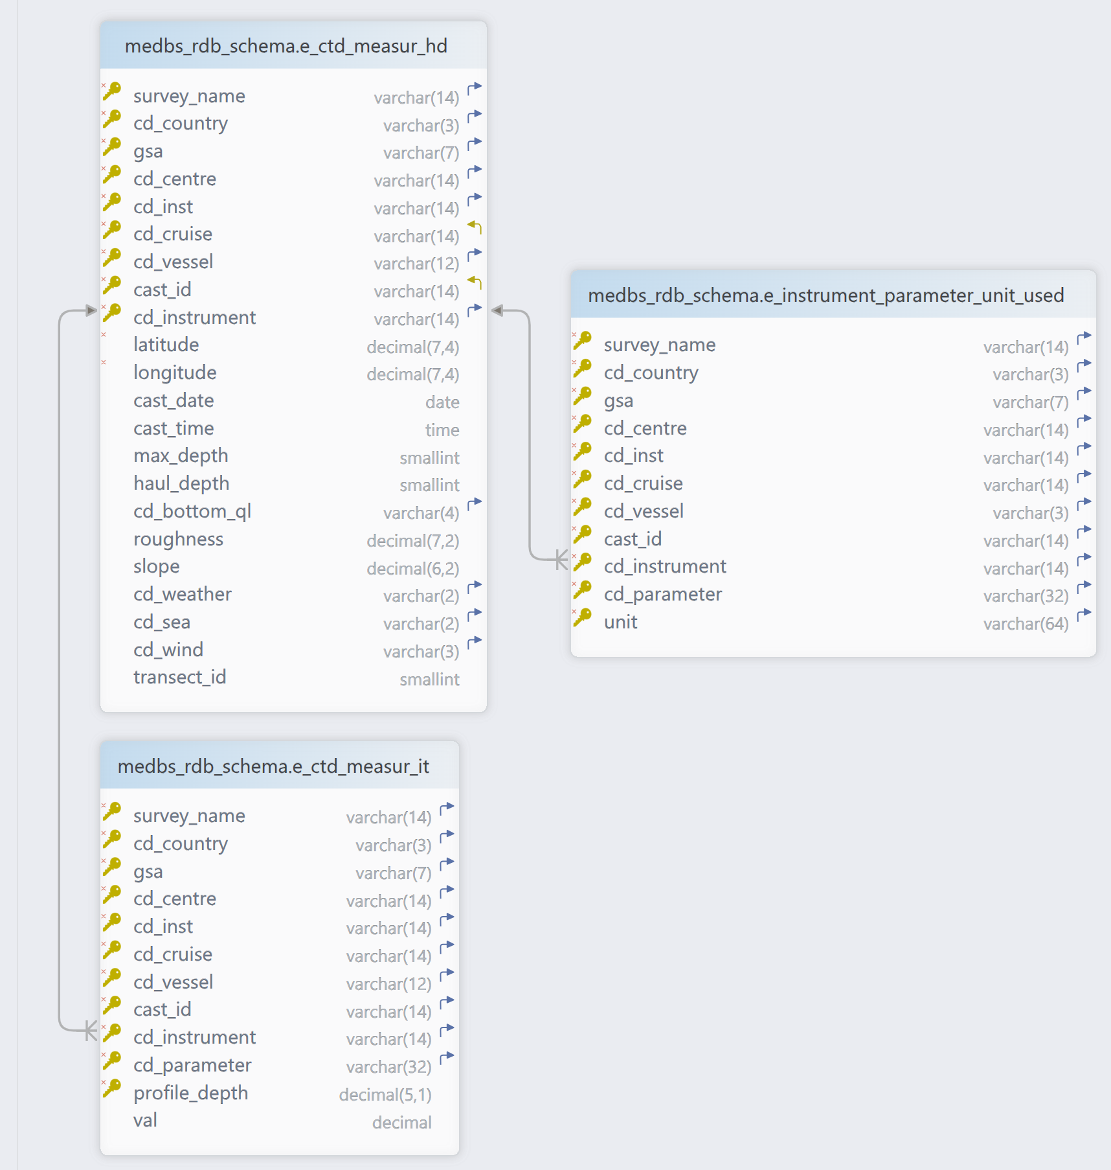
CTD data
collected from surveys in the Med&BS
The validation and upload of CTD data collected during the MEDITS survey can be supported by RDBFIS.
If requested by the group, we can extend the MEDITS component by adding a dedicated tab for handling CTD data.

Slide 8
Harmonization across RDBFIS, JRC, and GFCM Platforms
schema & syntactic rules
Multiple platforms (RDBFIS, JRC, GFCM DCRF)
Issues:
Divergent field names
Varying decimal precision tolerance
Code lists applied (species, gears, GSAs)
Different syntactic rules
RDBFIS: The validation scheme implemented in the RDBFIS was strictly aligned with the specifications defined in the various Annexes of the relevant EU/GFCM data calls and the survey handbooks.
The JRC system is more flexible with certain validation rules, particularly regarding the number of digits allowed after the decimal point.

Slide 9
System Harmonization across RDBFIS and JRC (Med&BS datacall)
JRC-RDBFIS meeting, 20 November 2025
Objective: To review and align the technical aspects and data validation rules between RDBFIS and JRC systems, ensuring consistency, interoperability, and accurate data exchange under the DCF / Med&BS datacall framework.
Main topics
Coding Systems and Species Lists
Validation Rules and Numerical Precision
ANNEX 1 Update
MEDITS-Specific Harmonization Issues
Next Steps and Coordination
Actions implemented following the meeting:
The harmonization process between the JRC and RDBFIS databases is nearly complete; a few remaining issues require further discussion and will be included as agenda items for the next meeting.
Regarding the MEDITS structure and validation rules, these will be addressed at the next meeting with JRC as: (a) the new MEDITS Handbook has been finalised and published, and (b) the outcomes of the meeting between RDBFIS and the MEDITS Chair have been circulated within the MEDITS group for review and agreement.

Slide 10

System Harmonization across RDBFIS and GFCM/DCRF datacalls
GFCM-RDBFIS meeting, 26 November 2025
Objective: To address the technical harmonization needs between the GFCM Data Collection Reference Framework (DCRF) and the RDBFIS platform.
Main topics
Participants from the RDBFIS consortium, DG MARE, and the GFCM Secretariat examined the current integration status, coding systems, data validation processes, spatial inconsistencies in GSA polygons, and upcoming changes in the DCRF structure.
Next meeting: GFCM will set the date

Slide 11
Harmonization among RDBFIS and MEDITS
MEDITS Chair and RDBFIS Consortium online meeting, 2 December 2025
Objective: Revision of the MEDITS new Handbook and species list
Main topics
The discussion focused on:
assessing the impact of the changes introduced in the MEDITS data structure on the RDBFIS platform, including the database, the integrated R packages (RoME, BioIndex, and RDBQC), the backend, frontend, and validation schema (reordering of the column NUMBER_OF_THE_STRATUM in table TA, removal of the columns CODEND_CLOSING and PART_OF_THE_CODEND from tables TA and TB, addition of new columns-STATION_NUMBER and DOOR_OPENING to table TA);
Matching of the MEDITS TM species list with WoRMS and ASFIS.
Actions: the outcomes of the meeting has been circulated within the MEDITS group for review and agreement.

Slide 12
Establishing collaboration with other consortia
A constructive collaboration between the DIASPARA and RDBFIS consortia has been initiated to explore potential pathways for future integration. DIASPARA is currently assessing long-term hosting solutions, including RDBFIS and RDBES.
The proposed approach is for diadromous data collected under the Med&BS framework to be hosted within RDBFIS, enabling functionalities such as syntax and consistency checks, data upload, and data call generation. The DIASPARA consortium has already shared detailed information on the existing database structure, and further technical discussions are planned throughout 2026.

Slide 13
MEDITS: further improvements & new functionalities
Suggestions from the MEDITS group for further improvements or new functionalities (e.g. maps, graphs)

Slide 14
Med&BS RDBFIS-III: Comments & Discussions
Thank you for your attention

Slide 15
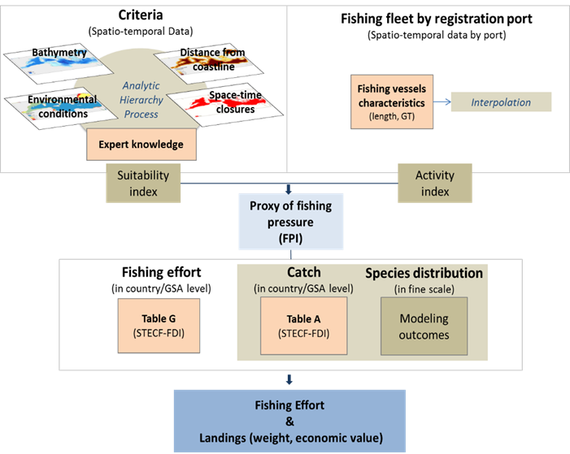
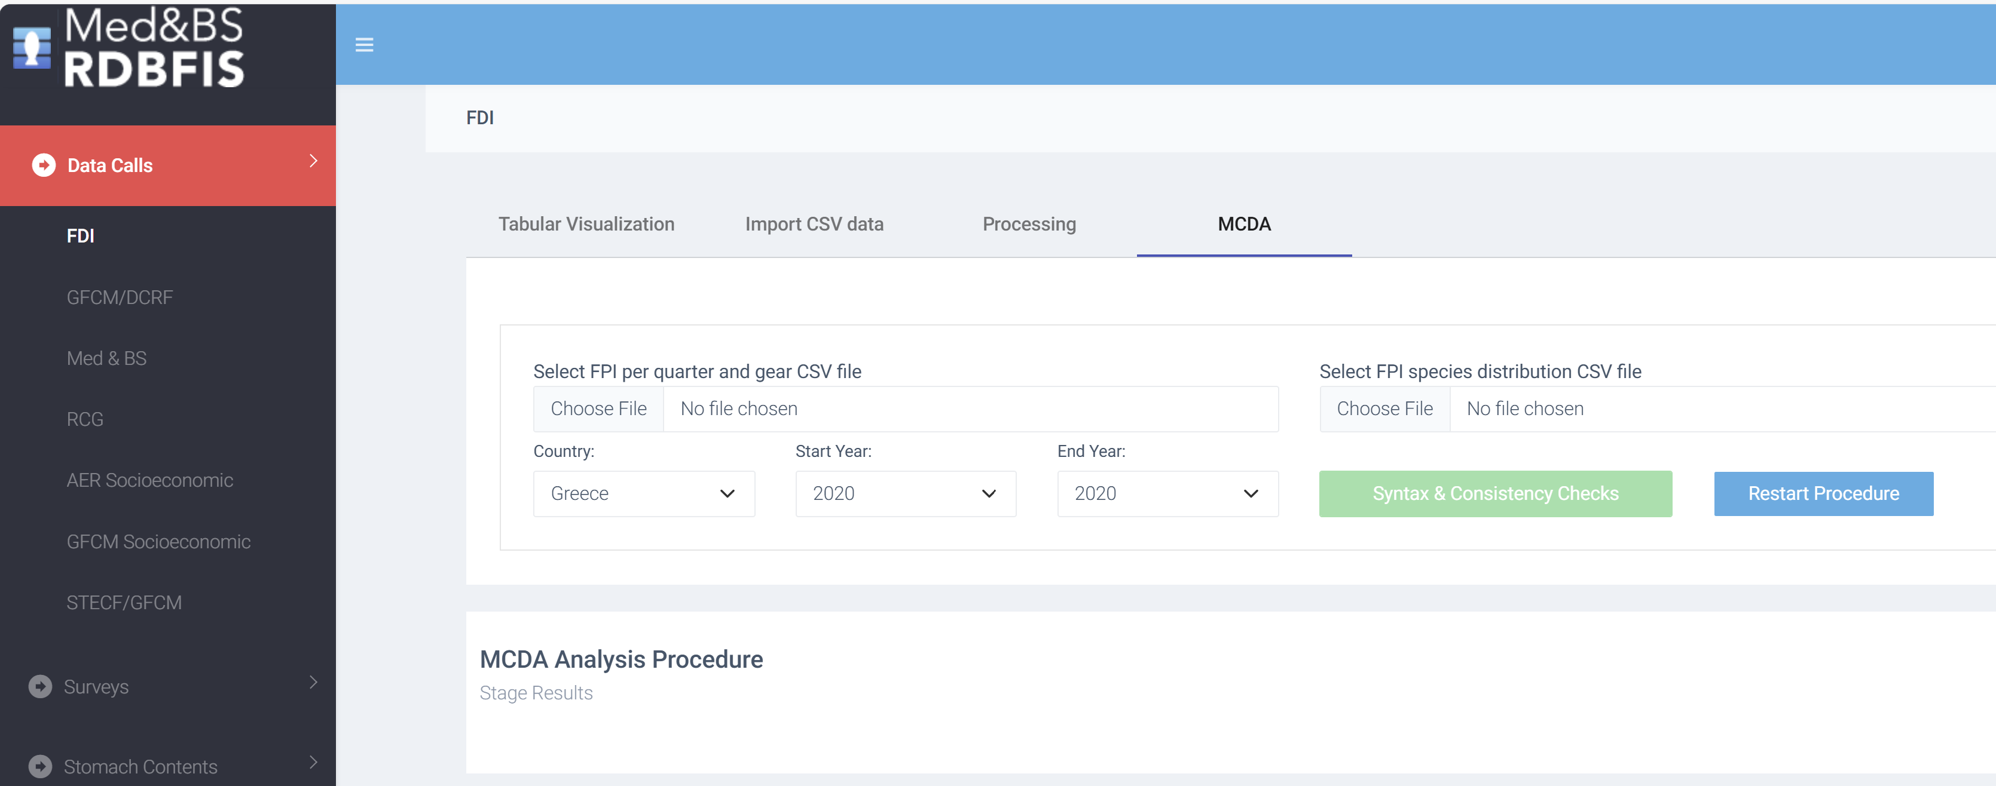
An innovative R package* is designed to estimate the spatial effort, weight, and value of landings in small-scale fisheries (SSF) for data-limited scenarios, specifically for vessels under 12 meters in length. The R package has been integrated into RDBFIS, facilitating the estimation of fishing effort and landings in the format of Tables H and I.
Estimating the spatial FE & landings for SSF (FDI Tables H, I)
- integration within RDBFIS
* Maina, I., Politikos, D. and Kavadas, S., 2026. tools4MCDA: An R-Package to estimate spatial fishing effort, weight and value of landings using multi-criteria decision analysis. Ecological Modelling, 516, p.111541.
https://doi.org/10.1016/j.ecolmodel.2026.111541

Slide 16
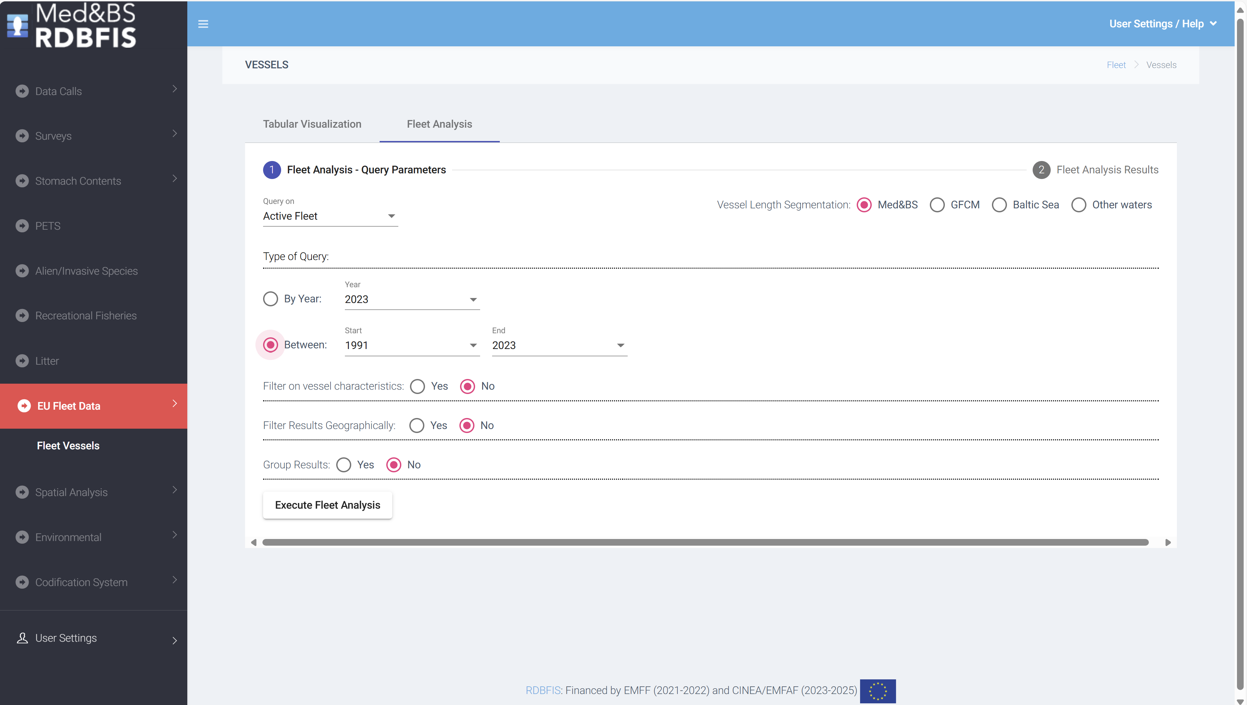
EU fleet analysis
Fleet analysis: an open access dynamic tool has developed to illustrate the evolution of the fleet dynamics in Europe; potential links with the landings, discards and value (FDI Table A);
Data from the professional fishing fleet, spanning the period from 1991 to 2024, was downloaded from the official EU Fleet Register portal. GIS techniques were employed to spatially join the fishing ports with various geographical entities, including NUTS2 and NUTS3, FDI subregions, Geographical areas (GFCM, ICES). The fishing ports were match to LOCODE from the CIRCAMB Master Data Register. The accuracy of the fishing port locations was validated using information available from the IFREMER Sextant portal.
Reports can be generated based on user-defined queries about active or decommissioned fishing vessels
Notes:
fleet analysis tool: potential links with the landings/discards/values – FDI table A

